Slide 1
360 degree flexible drilling machine
Mini – project

Slide 2
BACKGROUND
Drilling is the operation of producing a cylindrical hole of required diameter and depth by removing metal by the rotating edges of a drill. The drill bit is ﬁtted into the spindle of the drilling machine. Drilling holes in parts, sheets and structures is a regular industrial work. Perfect and well aligned drilling needs ﬁxed and strong drills. Some parts cannot be drilled using ﬁxed drills due to low space between drill bit and drill bed.
The purpose of our project is to rotate 360 degrees and make it more convenient to use.

Slide 3
PROBLEM STATEMENT
In basic drilling machines, there is a problem of movement of drilling machine in diﬀerent directions. Perfect and well aligned drilling needs ﬁxed and strong drills. Some parts cannot be drilled using ﬁxed drills due to low space between drill bit and drill bed . We need to use hand drills in such cases but hand drills have alignment problems .A method to drill even from some distance within tight spaces is required .

Slide 4
Objective
To design a 360-degree ﬂexible drilling machine.
To drill holes in various locations such as horizontal, vertical or even up &
down.
To perform operation with high accuracy.
To make the movement easier.
To reduce human eﬀort.
To eradicate mounting complications

Slide 5
Speciﬁcations
A. Motor -
Servo motor Rated voltage = 24V Working voltage = 12V
Speed = 10,000 rpm
Current variation = 0.2 - 1.2 amp Length of shaft = 14mm
B. Drill Bit: -
Twist drill bit = 3mm Length = 30mm
Material = HSS 2mm for wood , plastic , light materials.
C. Connecting Rod -
200mm 1st rod i.e. Outer Arm (Quantity-2) 200 inch 2nd rod i.e. Inner Arm (Quantity-1)

Slide 6
Constraints
Suitable for light/domestic use only.
Length Constraint:
Minimum distance of drill point from clamp=200 mm
Maximum distance of drill point from clamp=5000 mm
Noise: Motor should have minimum noise.

Slide 7
Components
MOTOR
CONNECTING ARM
DRILL BIT
BEARING
SCREWS

Slide 8
Components: Motor
A motor can be deﬁned as a electrical device which can be operated by using direct or single-phase AC supply at approximately the equivalent speed and with same output. The shaft started rotating when supply is on. Shaft is supports by bush in it when power is supply through a rectiﬁer. This shaft connects with the drilling bit through Chuck to rotates drilling bit and dill a hole on the workpiece when it required.

Slide 9
Components: Connecting Arm
Connecting arm is used to connects the two objects to each other for support between them to help to move as desired. In this we are using a rack and pinion mechanism over the arms to make it a telescopic arm compromising of the outer arm and inner arm for increasing and decreasing the length of the arm. The pinion is attached to the outer arm and the rack is attached to the inner arm which together makes motion between the arms.

Slide 10
Components
Drill Bit : The tools which are required to remove material in order to create holes or enlarge them, mostly of form of circular shape. Drill bits are available in variable sizes and shapes and can create diﬀerent kinds of holes as required for operation in many diﬀerent materials. It is made up of carbon steel. In our model we are assumed to use a drill bit of diameter of 2mm.
Screws : Single degree of movement kinematic pair used in mechanisms of screw joints. Screw joints facilitate single axis translation motion by the employ of the threads of the screws.
Bearings : A bearing is a mechanical device that combines respective movement to the desired movement of the bodies and also diminishes the friction between moving components.

Slide 11
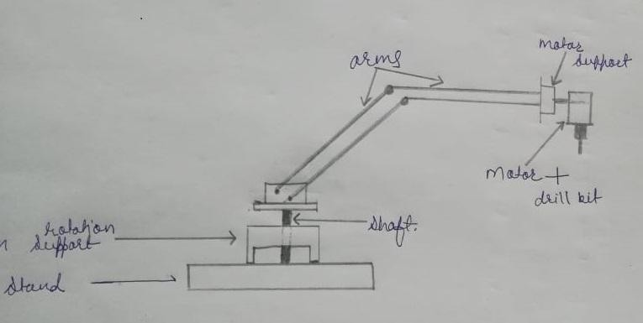
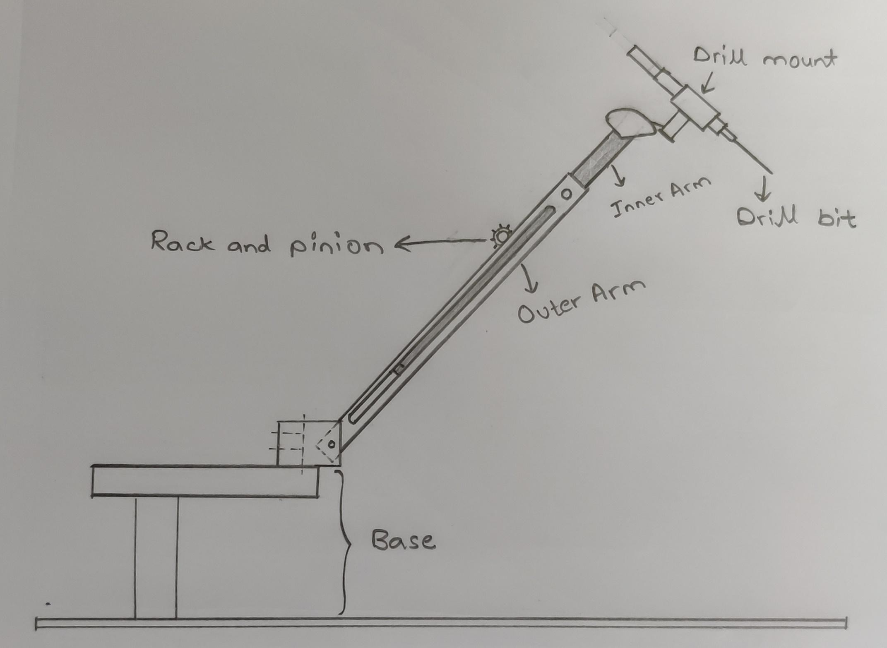
Conceptual Design :
Conceptual design 1
Conceptual design 2

Slide 12
Design Evaluation :
 | Conceptual design 1 (Score out of 10) | Conceptual design 2 (Score out of 10)
Hinge | 6 | 8
Base firmness | 7 | 6
Arm flexibility | 6 | 9
Drill mount | 5 | 8
Total score | 24 | 31

Slide 13
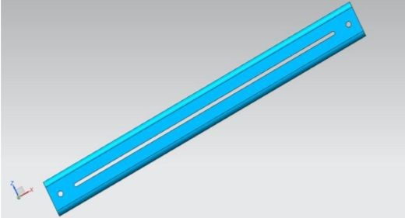
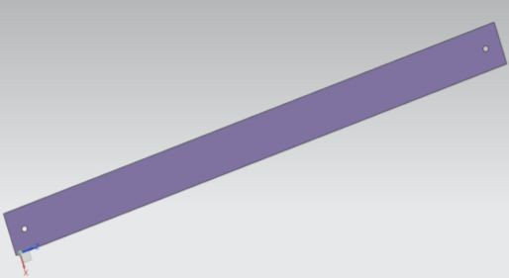
Design 1: Arm
Outer Arm
Inner Arm

Slide 14
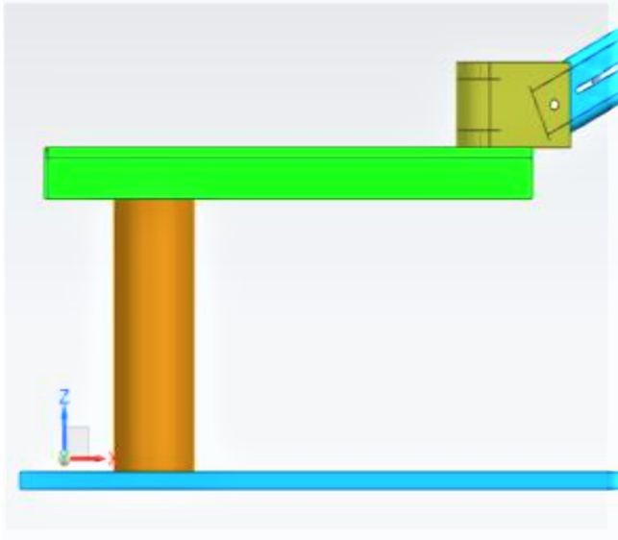
Design 2: Base

Slide 15
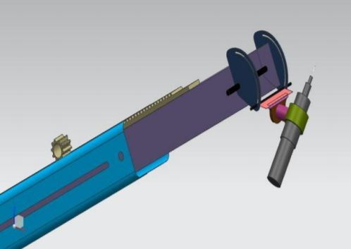
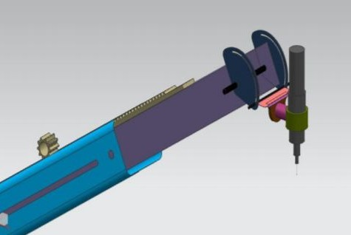
Design 3: Drill Mount

Slide 16
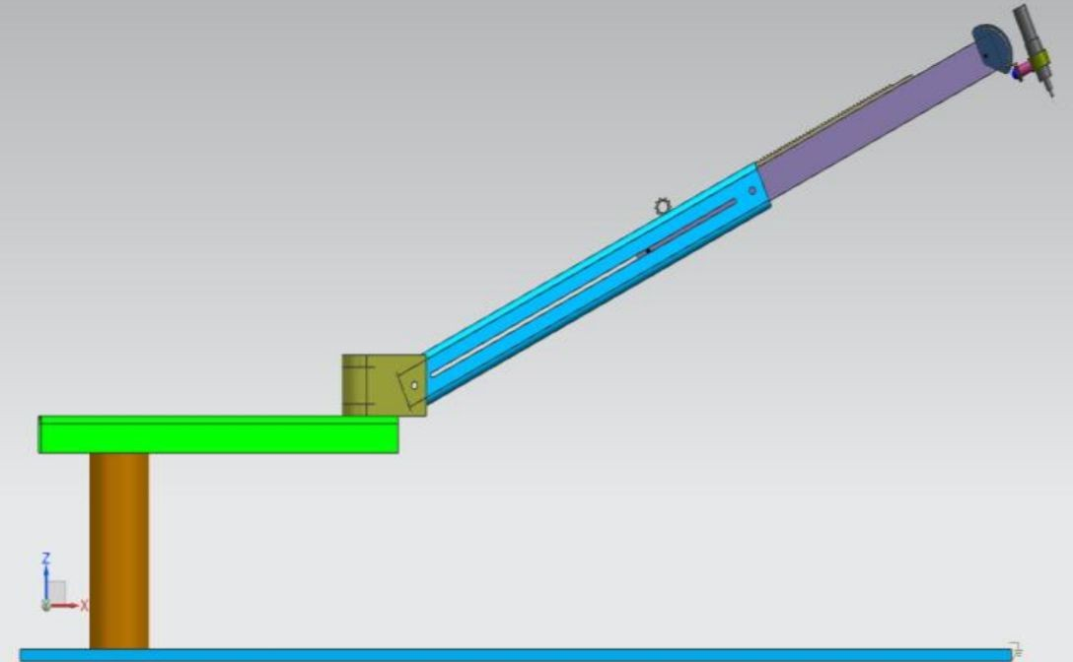
Full Assembly:

Slide 17
Concept Evaluation: Scoring out of 100
 |  | Design 1 : Arm | Design 2 : Base | Design 3 : Drill Mount
Selection criteria | Weight | Score | Score | Score
Ease of handling | 20% | 45 | 30 | 60
Ease of use | 20% | 45 | 60 | 60
Portability | 10% | 10 | 10 | 25
Durability | 10% | 20 | 10 | 30
Cost | 10% | 60 | 60 | 40
Stability | 30% | 50 | 75 | 75

Slide 18
Advantages
The setup of the machine is simple and compact.
Machine is easy to handle.
The machine can drill in any direction automatically.
It can drill in congested and diﬃcult place.
This method can reduce the setting time of operation.
The handling cost of machine will be reduce.

Slide 19
Future Scope
The complete automation can be achieve.
This machine can be used in every industry.
It will be more ﬂexible and easy to adjust.
The method of rotation of arm and drill can be used in machining operation.
The portability of a machine can be increase.
Locking of the base with the ﬂat surface can be improved.
This mechanism can also improvise in other machinery for easy movement and increase the productivity.

Slide 20
Conclusion
This gives the facility to work in-between the drill bit and drill bed where minimum spaces are available.
In this rack and pinion mechanism used over the arms to make it a telescopic arm for increasing and decreasing the length of the arm. Overall, space required is also minimum.
In this project we can drill as many holes as we required without moving the workpiece. Hence, it minimizes the error occurs due to human.

Slide 21
Thank You!

